Slide 1
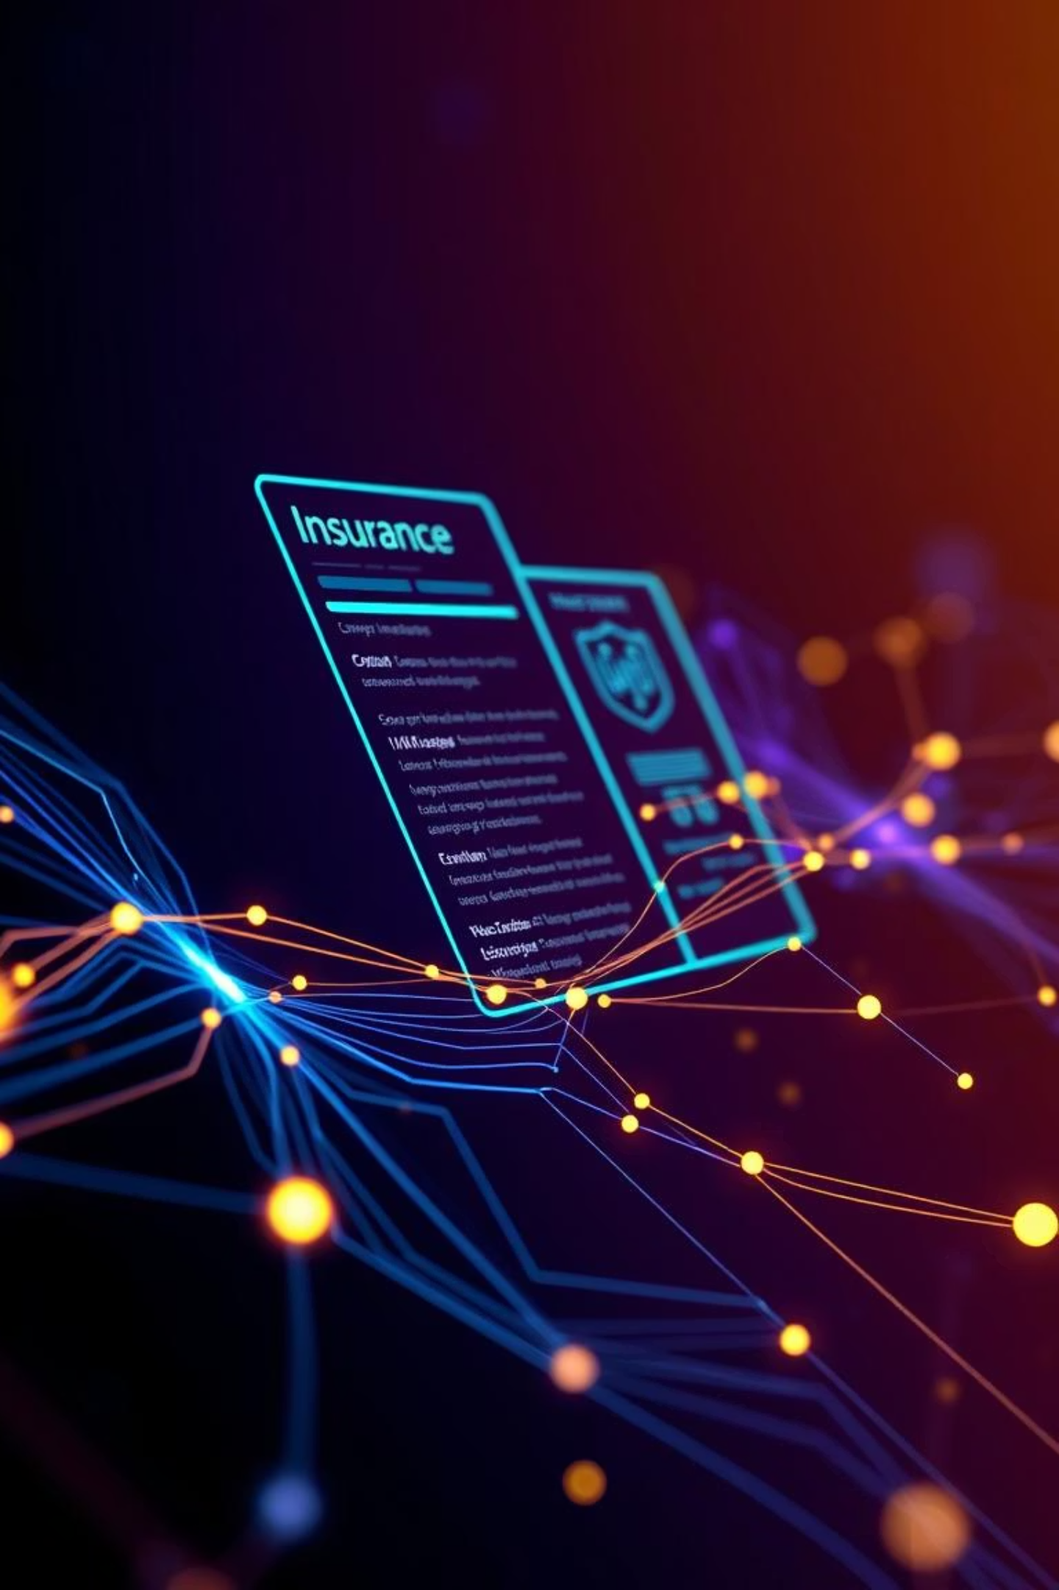
PolicyPal: Your Personal Insurance Guide
Ever wished insurance wasn't so complicated? We've all been there. PolicyPal is here to change that.
by Darshan Korde

Slide 2
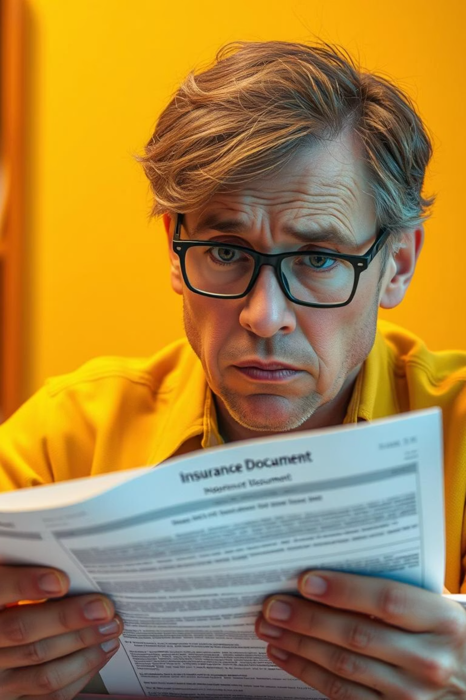
Problem Statement :
Insurance documents are long, complex, and hard to understand.
People often miss important details like exclusions or claim steps.
Choosing the right plan is confusing without expert help.
There’s a need for a smart assistant to simplify and guide users

Slide 3
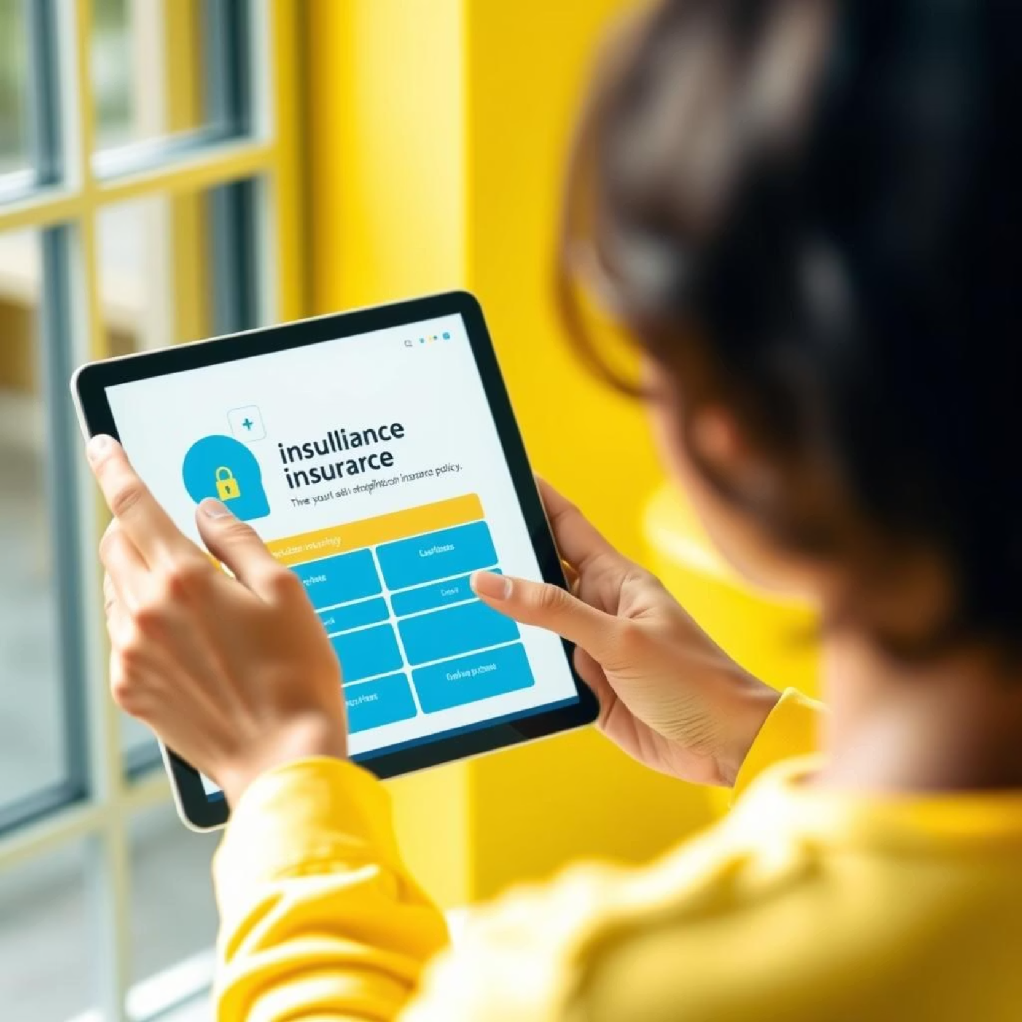
Introducing PolicyPal :
PolicyPal is a GenAI-powered assistant designed for the insurance sector.
It simplifies complex policy documents using natural language summarization.
Users can understand coverage, exclusions, and risk in seconds.
PolicyPal also helps with claim letter drafting and answering queries.
It recommends suitable insurance plans based on age, income, and goals.
The goal is to make insurance easy, transparent, and user-friendly.

Slide 4





How PolicyPal Works
Upload Your Policy
Highlights & Analysis
Just upload your PDF. PolicyPal gets to work instantly.
Risky terms light up, and you get a clear coverage score.
Q&A and Summaries
Generate Documents
Ask anything or get a simple summary you can download.
Need a claim letter? We'll draft it for you.
Recommend Insurance
Recommend best insurance via InsureWise

Slide 5

Why Local AI?
Privacy & Performance
You might be wondering about the "AI" part. We use local AI models like Mistral and LLaMA2, and that's a big deal. It means your sensitive insurance data stays private—it never leaves your device or our secure environment. Plus, it's super fast!

Slide 6
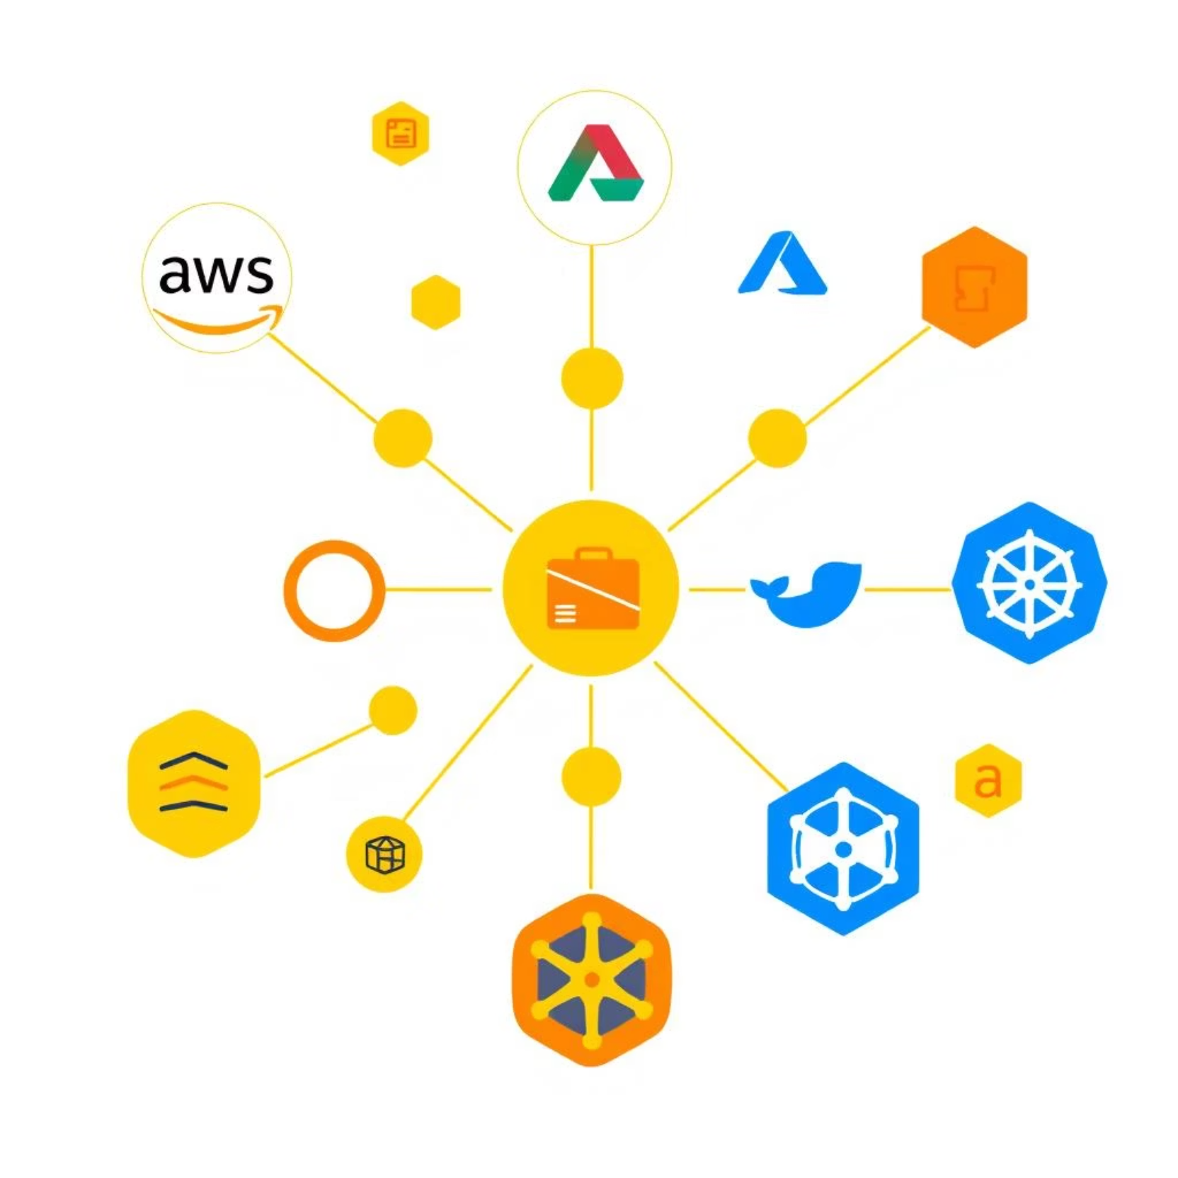
Behind the Scenes:
Our Tech Stack
Streamlit: Our user-friendly interface.
PyMuPDF: For handling those tricky PDFs.
Langchain with Ollama: Powering our local AI magic.
ReportLab & Matplotlib: For generating clean PDFs and visuals.

Slide 7



What's Next for PolicyPal?
Mobile App
Proactive Advice
Multi-Language Support
Bringing PolicyPal to your phone for on-the-go access.
More personalized recommendations based on life changes.
Expanding to help even more people understand their policies.

Slide 8
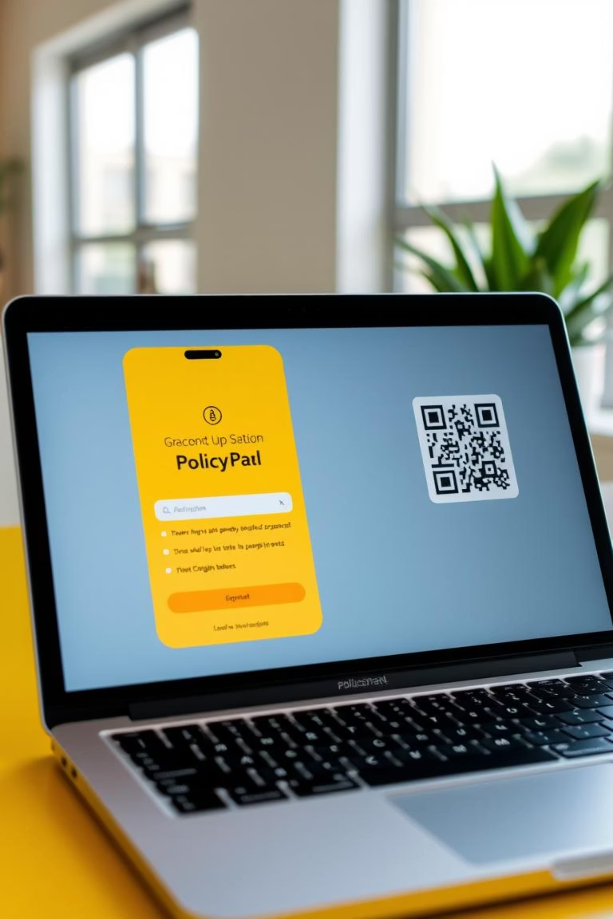


Ready to Try PolicyPal?
We're excited for you to experience PolicyPal! Scan the QR code or click the button below to check out the app. All the setup instructions are on our GitHub if you want to dive deeper.
UI Interface
⚠️Due to Streamlit Cloud limitations, LLM-based features are available only when running the app locally via Ollama. The hosted UI demonstrates the interface only

